Slide 1
Generating functions:
$$a_{n}=f(n);$$
$$A(q)=f(0)+f(1)q+f(2)q^{2}+f(3)q^{3}+...$$

Slide 2
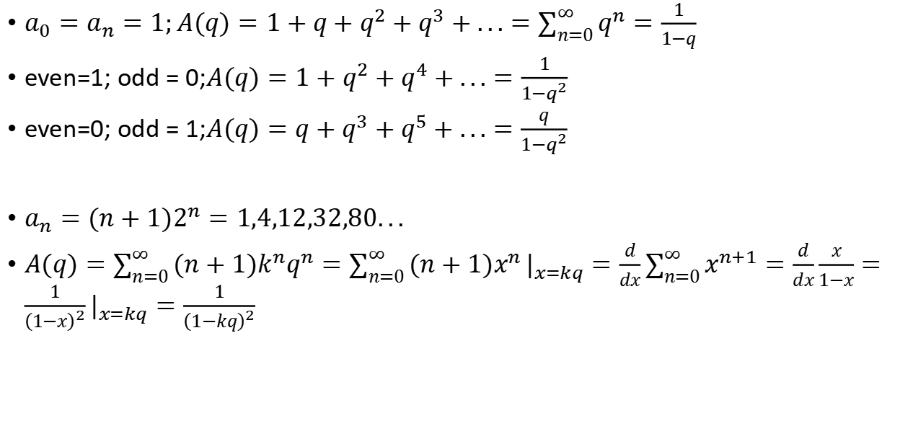
simple examples:
$a_{0}=a_{n}=1;A(q)=1+q+q^{2}+q^{3}+...=\sum_{n=0}^{∞}{q^{n}}=\frac{1}{1−q}$
even=1; odd = 0;$A(q)=1+q^{2}+q^{4}+...=\frac{1}{1−q^{2}}$
even=0; odd = 1;$A(q)=q+q^{3}+q^{5}+...=\frac{q}{1−q^{2}}$
$a_{n}=(n+1)2^{n}=1,4,12,32,80...$
$A(q)=\sum_{n=0}^{∞}{(n+1)k^{n}q^{n}}=\sum_{n=0}^{∞}{(n+1)x^{n}}|_{x=kq}^{}=\frac{d}{dx}\sum_{n=0}^{∞}{x^{n+1}}=\frac{d}{dx}\frac{x}{1−x}=\frac{1}{{\left(1−x\right)}^{2}}|_{x=kq}^{}=\frac{1}{{\left(1−kq\right)}^{2}}$

Slide 3
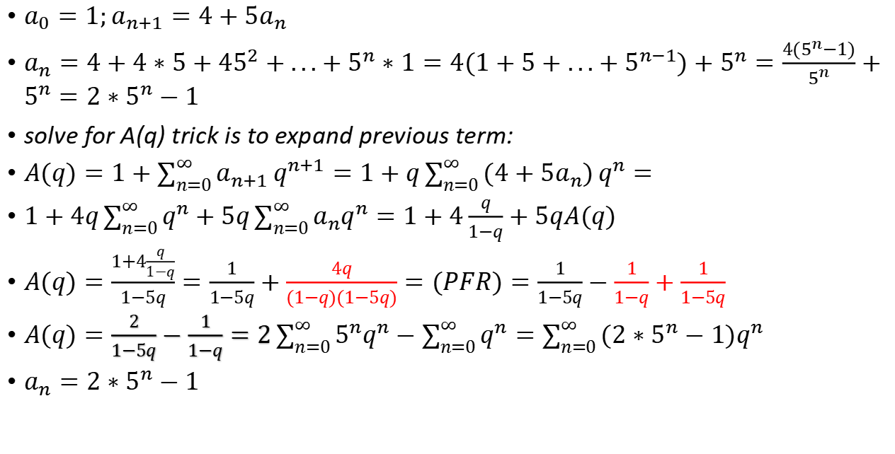
solve for A(q) trick is to expand previous term
$a_{0}=1;a_{n+1}=4+5a_{n}$
$a_{n}=4+4∗5+45^{2}+...+5^{n}∗1=4(1+5+...+5^{n−1})+5^{n}=\frac{4(5^{n}−1)}{5^{n}}+5^{n}=2∗5^{n}−1$
solve for A(q) trick is to expand previous term:
$A(q)=1+\sum_{n=0}^{∞}{a_{n+1}}q^{n+1}=1+q\sum_{n=0}^{∞}{(4+5a_{n})}q^{n}=$
$1+4q\sum_{n=0}^{∞}{q^{n}}+5q\sum_{n=0}^{∞}{a_{n}q^{n}}=1+4\frac{q}{1−q}+5qA(q)$
$A(q)=\frac{1+4\frac{q}{1−q}}{1−5q}=\frac{1}{1−5q}+\frac{4q}{(1−q)(1−5q)}=(PFR)=\frac{1}{1−5q}−\frac{1}{1−q}+\frac{1}{1−5q}$
$A(q)=\frac{2}{1−5q}−\frac{1}{1−q}=2\sum_{n=0}^{∞}{5^{n}q^{n}}−\sum_{n=0}^{∞}{q^{n}}=\sum_{n=0}^{∞}{({2∗5}^{n}−1)q^{n}}$
$a_{n}={2∗5}^{n}−1$

Slide 4
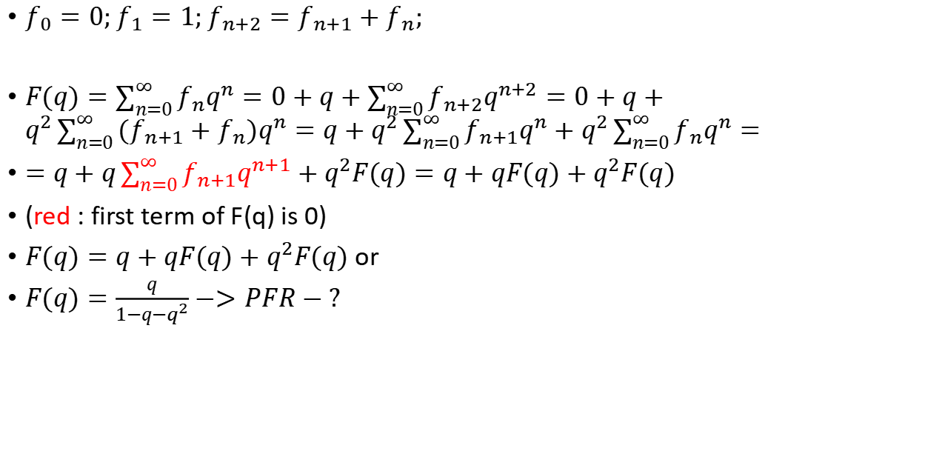
Fibo numbers:
$f_{0}=0;f_{1}=1;f_{n+2}=f_{n+1}+f_{n};$
$F(q)=\sum_{n=0}^{∞}{f_{n}q^{n}}=0+q+\sum_{n=0}^{∞}{f_{n+2}q^{n+2}}=0+q+q^{2}\sum_{n=0}^{∞}{(f_{n+1}+f_{n})q^{n}}=q+q^{2}\sum_{n=0}^{∞}{f_{n+1}q^{n}}+q^{2}\sum_{n=0}^{∞}{f_{n}q^{n}}=$
$=q+q\sum_{n=0}^{∞}{f_{n+1}q^{n+1}}+q^{2}F(q)=q+qF(q)+q^{2}F(q)$
(red : first term of F(q) is 0)
$F(q)=q+qF(q)+q^{2}F(q)$ or
$F(q)=\frac{q}{1−q−q^{2}}−>PFR−?$

Slide 5
todo: sequence: 1,2,3,1,2,3...

Slide 6

$a_{0}=3;a_{n+1}=n+1+3a_{n}$
$A(q)=3+\sum_{n=0}^{∞}{a_{n+1}}q^{n+1}=3+q\sum_{n=0}^{∞}{(n+1+3a_{n})}q^{n}$
$=3+\sum_{n=0}^{∞}{(n+1)q^{n+1}}+3q\sum_{n=0}^{∞}{a_{n}}q^{n}=3+\frac{q}{{\left(1−q\right)}^{2}}+3qA(q)$
$A(q)(3q−1)+3+\frac{q}{{\left(1−q\right)}^{2}}=0$
$A(q)=\frac{3}{1−3q}+\frac{q}{{\left(1−q\right)}^{2}(1−3q)}$

